Slide 1
PASCAL2 (FP7-IST-NoE) Pattern Analysis, Statistical Modeling and Computational Learning
2
Overview
John Shawe-Taylor, Steve Gunn,
Bill Triggs, Sami Kaski, David Barber, Claudio Gentile, Mikio Braun, Jose Balcazar, Michèle Sebag, Nicola Cancedda, Mitja Jermol, Alfons Juan, Petri Myllymaki, Nicolò Cesa-Bianchi

Slide 2
Mission statement
PASCAL2 will enable a refocusing of the Distributed Institute created in PASCAL towards the emerging challenges created by the ever expanding applications of adaptive systems technology and their central role in the development of large scale cognitive systems.

Slide 3
Core Challenges
Complexity in prior knowledge: language, stochastic differential equation models, etc
Learning in multi-component systems: agent learning, cognitive systems, etc
Partial or delayed feedback: semi-supervised learning, reinforcement learning, exploration vs. exploitation, etc.
Representation and architecture: multimodal processing, symbolic vs subsymbolic, probabilistic inference
Scalability and roll-out of adaptive systems technology: plug and play solutions scaling to very large data processing tasks, embedded software development

Slide 4
Management Structure
Strategic Advisory Council
Steering Committee – executive body meeting twice yearly – coordinators, programme managers, gender issues rep, finance and executive officers (~20 people).
Executive Committee – Executive Officer (UCL), Finance Officer (Soton), Coordinators
Individual Programme Committees/Managers
Assembly – one representative from each site

Slide 5
Programme Managers
Programme | Manager | Co-Manager
Knowledge Management | Steve Gunn, Soton-ECS | John Shawe-Taylor, UCL
Scientific Management | John Shawe-Taylor, UCL | Steve Gunn, Soton-ECS
Operational Management | Steve Gunn, Soton-ECS | John Shawe-Taylor, UCL
Balance & Integration | Dunja Mladenic, JSI | Bill Triggs, CNRS
Site Activity | Bill Triggs, CNRS | Chris Williams, UEDIN
Infrastructure | Neil Lawrence, Sheffield | Mikio Braun TUB
Harvest | Nicola Cancedda, XRCE | Michele Sebag, CNRS
Challenges | Michele Sebag, CNRS
Conference & Workshop Organisation | Sami Kaski, HUT | Peter Grunwald, CWI

Slide 6
Programme Managers
Programme | Manager | Co-Manager
Internal Visiting | Claudio Gentile, UniInsubria
Conference & Workshop Attendance | Petri Myllymaki, UH | Stefan Harmeling MPI
External Visitor | Nicolo Cesa-Bianchi, UMIl
Curriculum Development | Colin de la Higuera, CNRS | Jose Balcazar, UPC
Liaison | Florence d’Alché, CNRS | Marko Grobelnik, JSI
Brokerage of Expertise & Public Outreach | David Barber UCL | Nello Cristianini, UoB
Industrial Club, IPR and Exploitation | Marko Grobelnik, JSI | Nicola Cancedda, XEROX SAS
Pump priming | Dunja Mladenić JSI | Nicolò Cesa-Bianchi Milan

Slide 7
Work Packages
WP | Organisational Programme | Programme Tasks
WP1 | Operational & Knowledge Management | Operational Management Knowledge Management
WP2 | Scientific Integration & Co-ordination | Scientific Management Balance & Integration Site Activity monitoring Theme Management
WP3 | Joint Research | Pump-Priming Harvest Challenges Conference & Workshop Organisation
WP4 | Mobility | Internal Visiting Conference & Workshop Attendance External Visitor
WP5 | Outreach | Curriculum Development Liaison Brokerage of Expertise & Public Outreach Industrial Club, IPR & Exploitation Knowledge 4 All Foundation

Slide 8
Funding/activities
33% of funding for site allocation, remainder for programme activities
Second, third, fourth and fifth year site allocation was decided by normal procedure
Funding implementation for non-B members is working smoothly
Delayed transition to Beneficiary status for five Non-beneficiaries has been finalised
Percentage of funding across the programmes has remained unchanged, but some programmes reduced in final year

Slide 9
Breakdown of Programme budget
WP | Programme | Budget (%)
WP1 | Knowledge Management | 6.0
 | Operational Management | 9.5
WP2 | Scientific Management | 4.5
 | Balance & Integration | 0.5
 | Site Activity | 0.5
 | Theme Management | 0.5
WP3 | Infrastructure/pump-priming | 12.0
 | Harvest | 5.0
 | Challenges | 6.0
 | Conference & Workshop Organisation | 11.0
WP4 | Internal Visiting | 4.0
 | Conference & Workshop Attendance | 2.0
 | External Visitor | 1.0
WP5 | Curriculum Development | 0.5
 | Liaison Programme | 0.5
 | Brokerage of Expertise & Public Outreach | 1.0
 | Industrial Club, IPR & Exploitation | 0.5
 | Site Activity Funding | 33.0
 | Reserve | 2.0
 | Total | 100.0

Slide 10
PASCAL – Yr 2 highlights
Establishment of a PASCAL web portal, compute cluster, virtual meeting, and Source Forge collaborative facilities
Repository of technical reports with ~3000 entries
~15 Pump-priming research projects
~25 challenges, eg VOC, RTE, Explor. vs exploit.
Establishment of a brokerage of expertise web portal
~120 Workshops and summer schools on different project topics focussed around thematic programmes
~ 1000 Recorded lectures from many PASCAL workshops, tutorials, summer schools (http://videolectures.net/pascal)
Draft curriculum developed for machine learning, Summer Schools and “Boot Camp” for new researchers

Slide 11
PASCAL - Some Statistics
PASCAL 1
56 Contractors + associate members
4+ year project: 2003–2008
Funding was €6M (inc. Swiss contribution)
Dual-band funding model: site funding and programmes
PASCAL 2
Initially 40 members – now 57 members
5 year project: 2008–2013
Funding: €6M
Same funding model

Slide 12
PASCAL2 Yr 2 Membership
Beneficiary Members
17 partners (cf PASCAL core sites) – now ~20
Sign full contract and Consortium Agreement
Non-beneficiary Members
Initially 23 members now increased to 36
Institution signs a Membership Agreement
Industrial Club Members
Sign lighter version of Membership Agreement
Key interaction through the Harvest Programme

Slide 13
Site Funding
Site grants are grassroots funding to allow teams to participate actively and achieve network goals
An aid to collaboration, integration...
Not a “payment” for excellence / general purpose funding...
Allows distributed management and reduces the number of small requests to programme coordinators

Slide 14
Site Funding - Principles
Reward a broad spectrum of activities
Evaluate many activity classes
Avoid narrow focus, extreme scores, arbitrary thresholds or cut-offs
Automate the evaluation as much as possible, but allow reviewers some discretion at site level
E.g. to correct for forseen changes in site activities: funding is for future activities, not a reward for past ones.

Slide 15
Headline Achievements

Slide 16
Headline Achievements
Workshop organisation, challenges and pump-priming activity has continued in line with experiences from first four years with continued submission of publications to the PASCAL repository.
Harvest programme sponsored to promote easy access to Videolectures, co-sponsored by Knowledge 4 All Foundation: La Vie (Learning Adapted Video Information Enhancer)
Harvest project to extend the functionality of the PASCAL data repository was funded
Challenges have continued to be organised through to the end of the network including one to be reported at the final review.
Joint meeting with EUCOGIII as final review meeting of PASCAL2

Slide 17
Headline Achievements
Network has continued to have a dominant presence at top ML conferences
Thematic programmes have in some cases set the agenda for international research focus: eg Partial or delayed feedback: bandit algorithms, reinforcement learning, exploration vs. exploitation, etc.
Challenges have had a disproportionate influence on a range of research communities: eg VOC, RTE, GREAT.

Slide 18
Headline Achievements
Pump priming has pump primed new research directions: eg CompLACS
CWOC has influenced international conference landscape, eg NIPS in Europe, 50% of NIPS workshops supported
Videolectures/K4All has established a unique portal for academic videos that is driving the development of online learning provision with recognition from UNESCO
Harvest programme has created systems that have impact, eg PronTO and La Vie

Slide 19
Headline Achievements
Organisation of one of the key machine learning conferences ICML2012 at a PASCAL site.
Organisation of the premier European Conference in Machine Learning ECML/PKDD 2012 at a PASCAL site.
Videolectures (and K4All) received the UNESCO World Summit Award for the best e-Science and Technology product of the decade.
Continued development of Knowledge 4 All Foundation including organisation of two events:
‘Large scale online learning and decision making’ with ComPLACS project and industrial sponsors
Co-creation of Emerging Trends in Academia aimed at understanding how technology can affect education in the age of online resources and MOOCs.

Slide 20
PASCAL Impact
There has been a major initiative to assess the impact of the PASCAL investment. This is included in the Final report and will be summarised in Brokerage presentation. Some findings include:
Percentage of papers at NIPS including a PASCAL author increased from 15% in 2002 to a maximum of 35%, but maintaining at over 25% on average.
Percentage of workshops supported by PASCAL increased from about 20% in 2002 to consistently being more than 50% during PASCAL2

Slide 21
PASCAL Impact
K4All organised an industry sponsored workshop on ‘Large-Scale Online Learning and Decision Marking’ in September 2012.
high profile speakers/companies involved in the large scale deployment of machine learning, including
Microsoft (Thore Graepel, Manik Varma, Sham Kakade, Leon Bottou, John Langford),
Netflix (Carlos Gomez-Uribe),
Facebook (Ralf Herbrich),
Xbox Live (Ulrich Paquet),
Causata (Leonard Newnham).

Slide 22
Operational Management Programme
Steve Gunn

Slide 23
Operational Management Programme
Monthly meetings of the Executive Committee to coordinate operational matters
Procedures for matching itemised billing entries to draft Form Cs has worked well for the first three year finances.
Request reporting annually with indication of closure or carry forward.
Itemised billing and funding requests localised by year to enable accurate budgeting and “recycling” of unused funding.
Remaining budget estimated and re-allocated in Steering Committee meetings in final year. Conservative approach to allow for exchange rate fluctuations.

Slide 24
Programme Requests
Request
0
Accept
Reviewers
1
For beneficiaries this will be actionable by the site manager and one other appointed site administrator (could be a researcher or a local administrator)
For non-beneficiary sites this will be actionable by the site administrator at UCL.
Approve
9
3
Reject
Itemised Billing
Researcher
4
Programme Manager
Final Report
Reviewer
8
5
Coordinator
Accept
Administrator
7
Site Manager/
Site Administrator
Completed

Slide 25
Scientific and Thematic Programme Management
John

Slide 26
Cognitive Architecture and Robotics
Thematic programme on ‘Cognitive Architectures and Robotics’ organised
European Workshop on Reinforcement Learning 2012 has been supported by the thematic programme
workshop for IROS 2012 was successfully supported by the thematic program with co-funding from EUCOG-III.
workshop at NIPS 2012 on Multi-Trade-offs in Machine Learning
Continued collaboration with CompLACS project linking ML with robotics platform and news analysis platform developed by PASCAL

Slide 27
Cognitive Inference and Neuroimaging
2nd International Workshop on Pattern Recognition in Neuroimaging (PRNI) that was initiated by the TP: over 100 people with proceedings published by IEEE
Toolkit PronTo (developed by a Harvest programme project) team have continued to run training events and extend the s/w
NIPS workshop on Machine Learning and Interpretation in NeuroImaging organised at NIPS 2012
Both workshops to be continued…

Slide 28
Activity recognition: a machine learning approach
iStethoscope challenge was hosted at AISTATs 2012
Segmenting heart data
Classifying heart data into four categories: funding used to pay doctors to do this
mobile computing data collection to create large datasets for activity analysis
Baseline system created
Data collection underway

Slide 29
Machine learning for multimodal interaction
Translectures project funded from Nov 11:
Automatic subtitling of videos
Involving Knowledge 4 All
La Vie (Learning Adapted Video Information Enhancer) Harvest project co-funded by Translectures
Proof of concept recommendation system that provide users with advice on suitable videos for their needs based on ml techniques
ICGI 2012 (International Conference on Grammatical Inference) organised by TP

Slide 30
Machine learning for multimodal interaction
ICMI Multimodal Grand Challenge organised as part of the International Conference on Multimodal Interaction (ICMI 2012)
Final Challenge co-organised with Translectures including Knowledge 4 All Foundation for completion at final meeting: IASD: Interactive Annotation of Sequential Data

Slide 31
Workshop Organisation Programme
Sami

Slide 32
Workshop programme
Manager: Sami Kaski, Aalto University
Mission: Help fund workshops
About core machine learning themes
To connect to the outside world
Processes:
Core workshop: 2 reviewers, 2500-4000€
Non-core: Program manager decides, ≤2500€
Steering:
Mostly bottom-up, with quality control by refereeing
A few planned bigger events
Additional steering by Thematic programmes

Slide 33
Workshop programme
Year Five
Two calls for workshops plus running call
In total still 39 workshops

Slide 34
Workshop programme
Sample workshops
European Workshop on Reinforcement Learning
ECML/PKDD Workshop on Community Mining and People Recommenders
Large-Scale Online Learning and Decision-Making Workshop
19th Machine Learning Summer School
International Workshop on Pattern Recognition in Neuroimaging (PRNI) that was initiated by PASCAL but will continue

Slide 35
Workshop programme
Highlights in 2012:
Three of the main conferences, AISTATS, ICML and ECMLPKDD were organized by PASCAL sites
Three summer schools, one co-located with AISTATS
Strong presence at NIPS was continued (7 workshops)
Notes:
COLT: PC: Ulrike von Luxburg, local: András György
ICMI: PC Daniel Gatica-Perez, general: Herve Boulard, Enrique Vidal
ICML: general chair Zoubin Ghahramani
UAI: general chair Peter Grunwald
NIPS: general chair John Shawe-Taylor

Slide 36
Pump-priming Report
Dunja Mladenić, Nicolò Cesa-Bianchi

Slide 37
PASCAL2 Pump-priming Overview
Call I: end of May 2008, 5 proposals, 3 accepted
Budget: 135 025 EUR, Y1 (20%), Y2 (40%), Y3: rest
Presentations at PASCAL2 Workshop, September 2009
Call II: mid June 2009, 6 proposals, 2 accepted
Budget: 96 000 €, Y2 (20%), Y3: (20%), Y4: (35%), Y5: rest
Presentations at PASCAL2 Workshop, March 2012
Call III: mid June 2010, 12 proposals, 3 accepted
Budget: 149 402 € (after reducing 81k EUR -> 61k EUR)
Presentations planned for March or September 2012
No calls in 2011
Total budget distributed: 380 527k €

Slide 38
Pump-priming projects Call I http://videolectures.net/ecmlpkdd09_pascal_steering/ (pascal_meet2009)
Modelling Learning and Co-Learning Curves for Application to Cognitive-Interfaces, 1.10.2008 – 31.03.2010 -> 28.2.2011 https://patterns.enm.bris.ac.uk/projects/co-learning
Total: 27175 €, Concluded
publication “Learning the Preferences of News Readers with SVM and Lasso Ranking”, AIAI-2010 conference
Learning and Inference in Structured, Higher Dimensional Stochastic Differential Systems, 1.1.2009 – 31.08.2009 -> 1.12.2010
Total: 43 350 €, Concluded
a joint grant submission to EPSRC on “Learning and Inference in Stochastic Differential Systems applied to Epilepsy”
publication “Particle smoothing in continuous time: a fast approach via density estimation”, journal IEEE Transactions in signal processing
Context Models for Textual Entailment and their Application to Statistical Machine Translation, 1.11.2008–31.01.2010->31.12.2010 http://u.cs.biu.ac.il/~nlp/te-smt/
Total: 64 500 €, Concluded
Publications at ACL-2009 conference, EAMT 2010 conference, Workshop on Machine Translation and Morphologically-rich Languages 2011

Slide 39
Pump-priming projects Call II
Sparse Reinforcement Learning in High Dimensions, 1.10.2009 – 30.09.2012, 45 000 €, https://sites.google.com/site/sparserl/
9 conference papers (3 NIPS papers 2009 and 2010, IEEE Allerton 2010, IEEE CDC 2010, ECMLPKDD 2010, EWRL 2011, ICML 2011, AISTAT 2012)
Feature selection in Reinforcement Learning, mainly using a sparsity inducing penalty l1
Compressed Sensing for improving linear bandit algorithms when the unknown parameter is assumed to be sparse
The project extended due to delays in a partner joning PASCAL2
Semi-supervised learning of semantic spatial concepts for a mobile robot, 1.1.2010 – 31.12.2012, 46 100 €
http://homes.dsi.unimi.it/~orabona/, 2 papers (CVPR 2010, ICML 2011)
Online algorithms for multiclass multikenel learning
Improved algorithms and analysis for online semi-supervised learning
The project extended due to difficulties with hiring personnel

Slide 40
Pump-priming projects Call III
Data-Dependent Geometries and Structures : Analyses and Algorithms for Machine Learning, 1.10.2010 – 30.09.2012
Total: 45 000 €, http://www.csml.ucl.ac.uk/projects/ddgas/
6 papers (NIPS-2010, NIPS-2011, DISCML 2011, AISTAT 2012, 2 journal sub.)
distribution dependent PAC-Bayes priors, efficiently algorithms (data dependent kernels, acyclic Markov Random Fields), fundamental inequalities, node and link classification on graphs
Bridging machine classification and human cognition: discriminative vs. generative learning, 1.7.2011 – 31.8.2012
Total: 43 402 €, http://ahsu.psychol.ucl.ac.uk/d-MCMCP/
3 paper submissions
structure of the category representations is important -> developing discrete-Markov Chain Monte Carlo with People (d-MCMCP) that uses MCMC sampling to examine the structure of human category representations over discrete objects
using d-MCMCP to understand how surgeons classify shoulder fractures, people's choice of hospitals, consumer preferences, moral representations, and facial emotions
Online Learning for Robot Control, 1.11.2010 – 31.12.2012
Total: 61 000 €
robotics data produced, designing and analyzing online algorithms

Slide 41
Infrastructure
Mikio Braun

Slide 42
mldata - Overview
Community website for the exchange of machine learning data sets funded by Pascal2.
Organized into
Data Sets: Raw data sets, raw or in a number of supported file formats
Learning Tasks: Focus on supervised learning
Learning Methods, Results: To track progress
Challenges: Collection of learning tasks

Slide 43
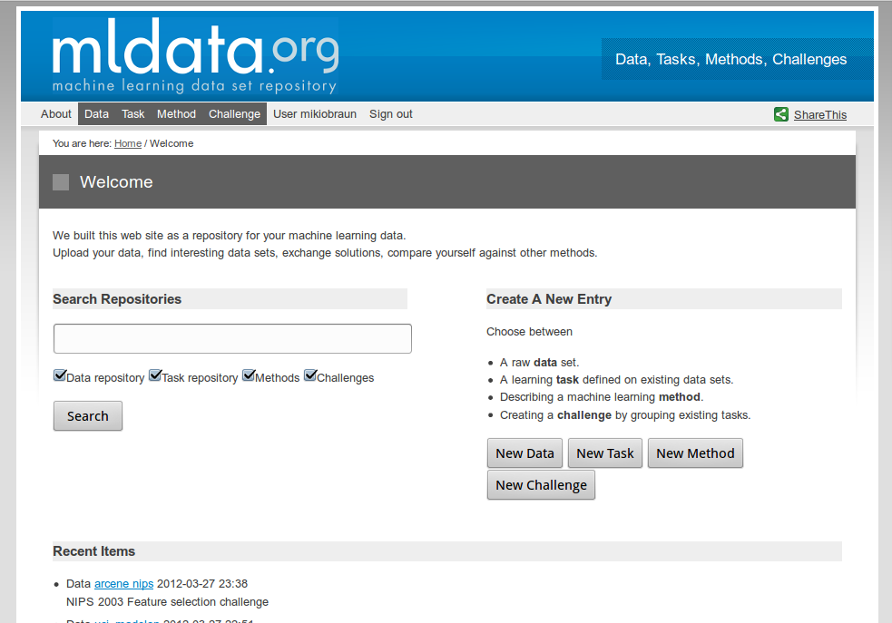
mldata – landing page

Slide 44
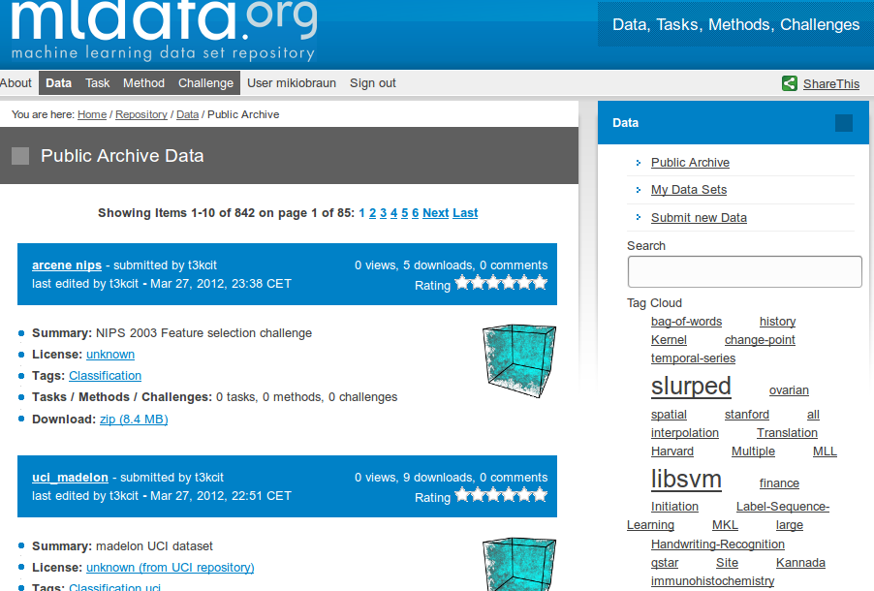
mldata – data sets view

Slide 45
mldata - Statistics
843 data sets, 30 learning tasks.
Hand populated data sets.
191 data sets from libsvm.
673 data sets from the Weka repository.
About 130k downloads in the last year, 150 per data set on average.
Most active ones are well-known data sets like the Iris, breast cancer, leukemia, Translation Initiation Site Pred, and MNIST data sets.

Slide 46
mldata - outlook
Supports DOI (unique data set ids) minting.
Interoperability with other Open Source Projects
OpenML (Pascal2 Harvest)
Scikitlearn, one of the important Python machine learning toolboxes
Challenge organization within mldata.
Indefinite hosting provided by TU Berlin.

Slide 47
Balance and Integration
Dunja Mladenić, Bill Triggs

Slide 48
B&I Activity
Budget usage:
Y1: 6000 €, Y2: 8500 €, Y3: 2000 €, Y4/5: 9000 €
Y4 no submission – transfer the budget to Y5
Activities in Y5
Encouraging women in PASCAL2 to provide their profiles to be publicly available on the Web site – link from http://www.k4all.org/ (3 000 EUR)
Interviews with female researchers for videolectures.Net – invite women in PASCAL and some outside PASCAL –@ ECLM PKDD 2012 (500 EUR)
Challenges and rewards of a career in research in various different cultures, few women in ICT research, real and perceived glass ceilings, work-life balance
One-on-one interviews and a small (3-4 people) group informal discussions
http://videolectures.net/womenscience2012_bristol/

Slide 49
Site Funding
Bill Triggs

Slide 50
Liaison Programme
Florence d’Alché

Slide 51
Liaison programme
Budget : 5000 euros
Actions related to Cognitive Science and Robotics community
- pursued the actions with EUCOGIII : special session with PASCAL2
At the 3rd EUCOGIII members conference, April 10-11, 2013 at Palma,
important delegation of PASCAL2 researchers – Jan Peters (Pascal2)
invited speaker:
- Workshop: Beyond Robot Grasping - Modern Approaches for
Learning Dynamic Manipulation organized in Vilamoura, Portugal by Heni
Ben Amor,Ashutosh Saxema, Oliver Kroemer and Jan Peters (Pascal2) jointly
to the international conference IROS 2012 (Workshop programme)

Slide 52
Liaison programme
Actions related to other communities
Statistical Physics of Inference and Control Theory
workshop organized in Granada (Spain),
September 12-16, 2012 about stochastic optimal control theory
and its links to inference, statistical mechanics and the theory
of large deviations.
Functional data analysis and operatorial statistics
workshop entitled “Object, functional and structured data: towards next
generation kernel-based methods”, organized jointly to ICML 2012, June 30
in Edinburgh (UK): community of functional data analysis and operatorial
statistics and those of kernel-based methods.

Slide 53
Challenge Programme
See separate presentation

Slide 54
Curriculum development programme report
Colin de la Higuera and
José Balcázar

Slide 55
TML 2012
Second Workshop on “Teaching Machine Learning”
Held in Edinburgh, on June 30th 2012, during ICML
40+ participants
Organisers: Kurt Driessens, Elisa Fromont
Agreement that Machine Learning is becoming a core topic in many universities, specifically hard to teach, and therefore useful to run this type of event.
http://swarmlab.unimaas.nl/TeachingML/

Slide 56
Ghana-PASCAL cooperation
Ghana follow-up jointly funded via CDP and External Visitors programmes
One Ghana student visited twice JLB at BCN
JLB visited Accra twice
Result: articles submitted
PASCAL2 fifth Year Review

Slide 57
Ghana: lessons learnt
Workshops, bootcamp, etc were a success
Large participation
Impact (local) (press coverage, institutions)
Key difficulties identified
Local motivation is essential: the need must be felt: research –at international level- is a very demanding activity
Local support is essential: local government (academia, business) have to support specifically with long term commitment

Slide 58
Internal Visiting
Claudio Gentile

Slide 59
Internal Visiting
Support visits between sites by Pascal2 members
(travel and subsistence, no salary)‏
Reshaped goal for final year of Pascal2:
visit to prepare ground for longer term collaborations
Final call to “visit to industry” scheme issued on July 2012
Activity in Y5:
- 13 standard visits
- 3 visits to industry (Telefonica, MSR Asia, Xerox)‏

Slide 60
Videolectures
Knowledge 4 All Foundation
See separate presentation

Slide 61
Legacy

Slide 62
Legacy projects
Translectures: out of videolectures/K4All
ComPLACS: pump-priming
Excitement: RTE challenge
…

Slide 63
PASCAL Legacy
Themes are emerging that could form the basis for a PASCAL3:
Scaling to large data through linear or sublinear time learning: eg integrating with information retrieval to select relevant data
Distributed learning: loosely connected sub-optimisations converging to global optimum
Intelligent search of large spaces as driver to attack big AI problems (cf MoGo)
EU Watson, but general purpose and rapidly reconfigurable
Privacy and confidentiality
Engaging the public in science

Slide 64
PASCAL Legacy
Breakdown of legacy:
Videolectures, eprints, CDP: NCAST box significantly reduces costs: potential for charity funding from benefactor but also K4All (and JSI) involvement in EU projects and UNESCO
Workshops: possibility of co-funding with industry (eg workshop with Causata Ltd last September and planned for this year again), also co-funding with other projects
Challenges: co-funding with sister projects or industry, eg CompLACS, EUCOGIII?
Harvest/pump-priming: possible industry sponsorship but again may create difficulties
Visits, Site funding, ...: very difficult to get support for this activity

Slide 65
Some possible ideas ...
EU funding for a further Network of Excellence
Would certainly need network to refocus and adjust membership
Could aligned with several of the work programmes
It seems Horizon 2020 will require significant SME involvement, but may be possibe

Slide 66
Some possible ideas
Company sponsorship:
Give company access to brand: Aaa PASCAL3
Ask them to give base support as a charity donation through K4All
Enable calls for specific focussed research projects in areas of interest to them through Harvest/Pump-priming programmes
Charity donations via K4All
Find a donor prepared to support the network to develop such activities as videolectures and outreach to third world, while maintaining the research infrastructure

